Slide 1
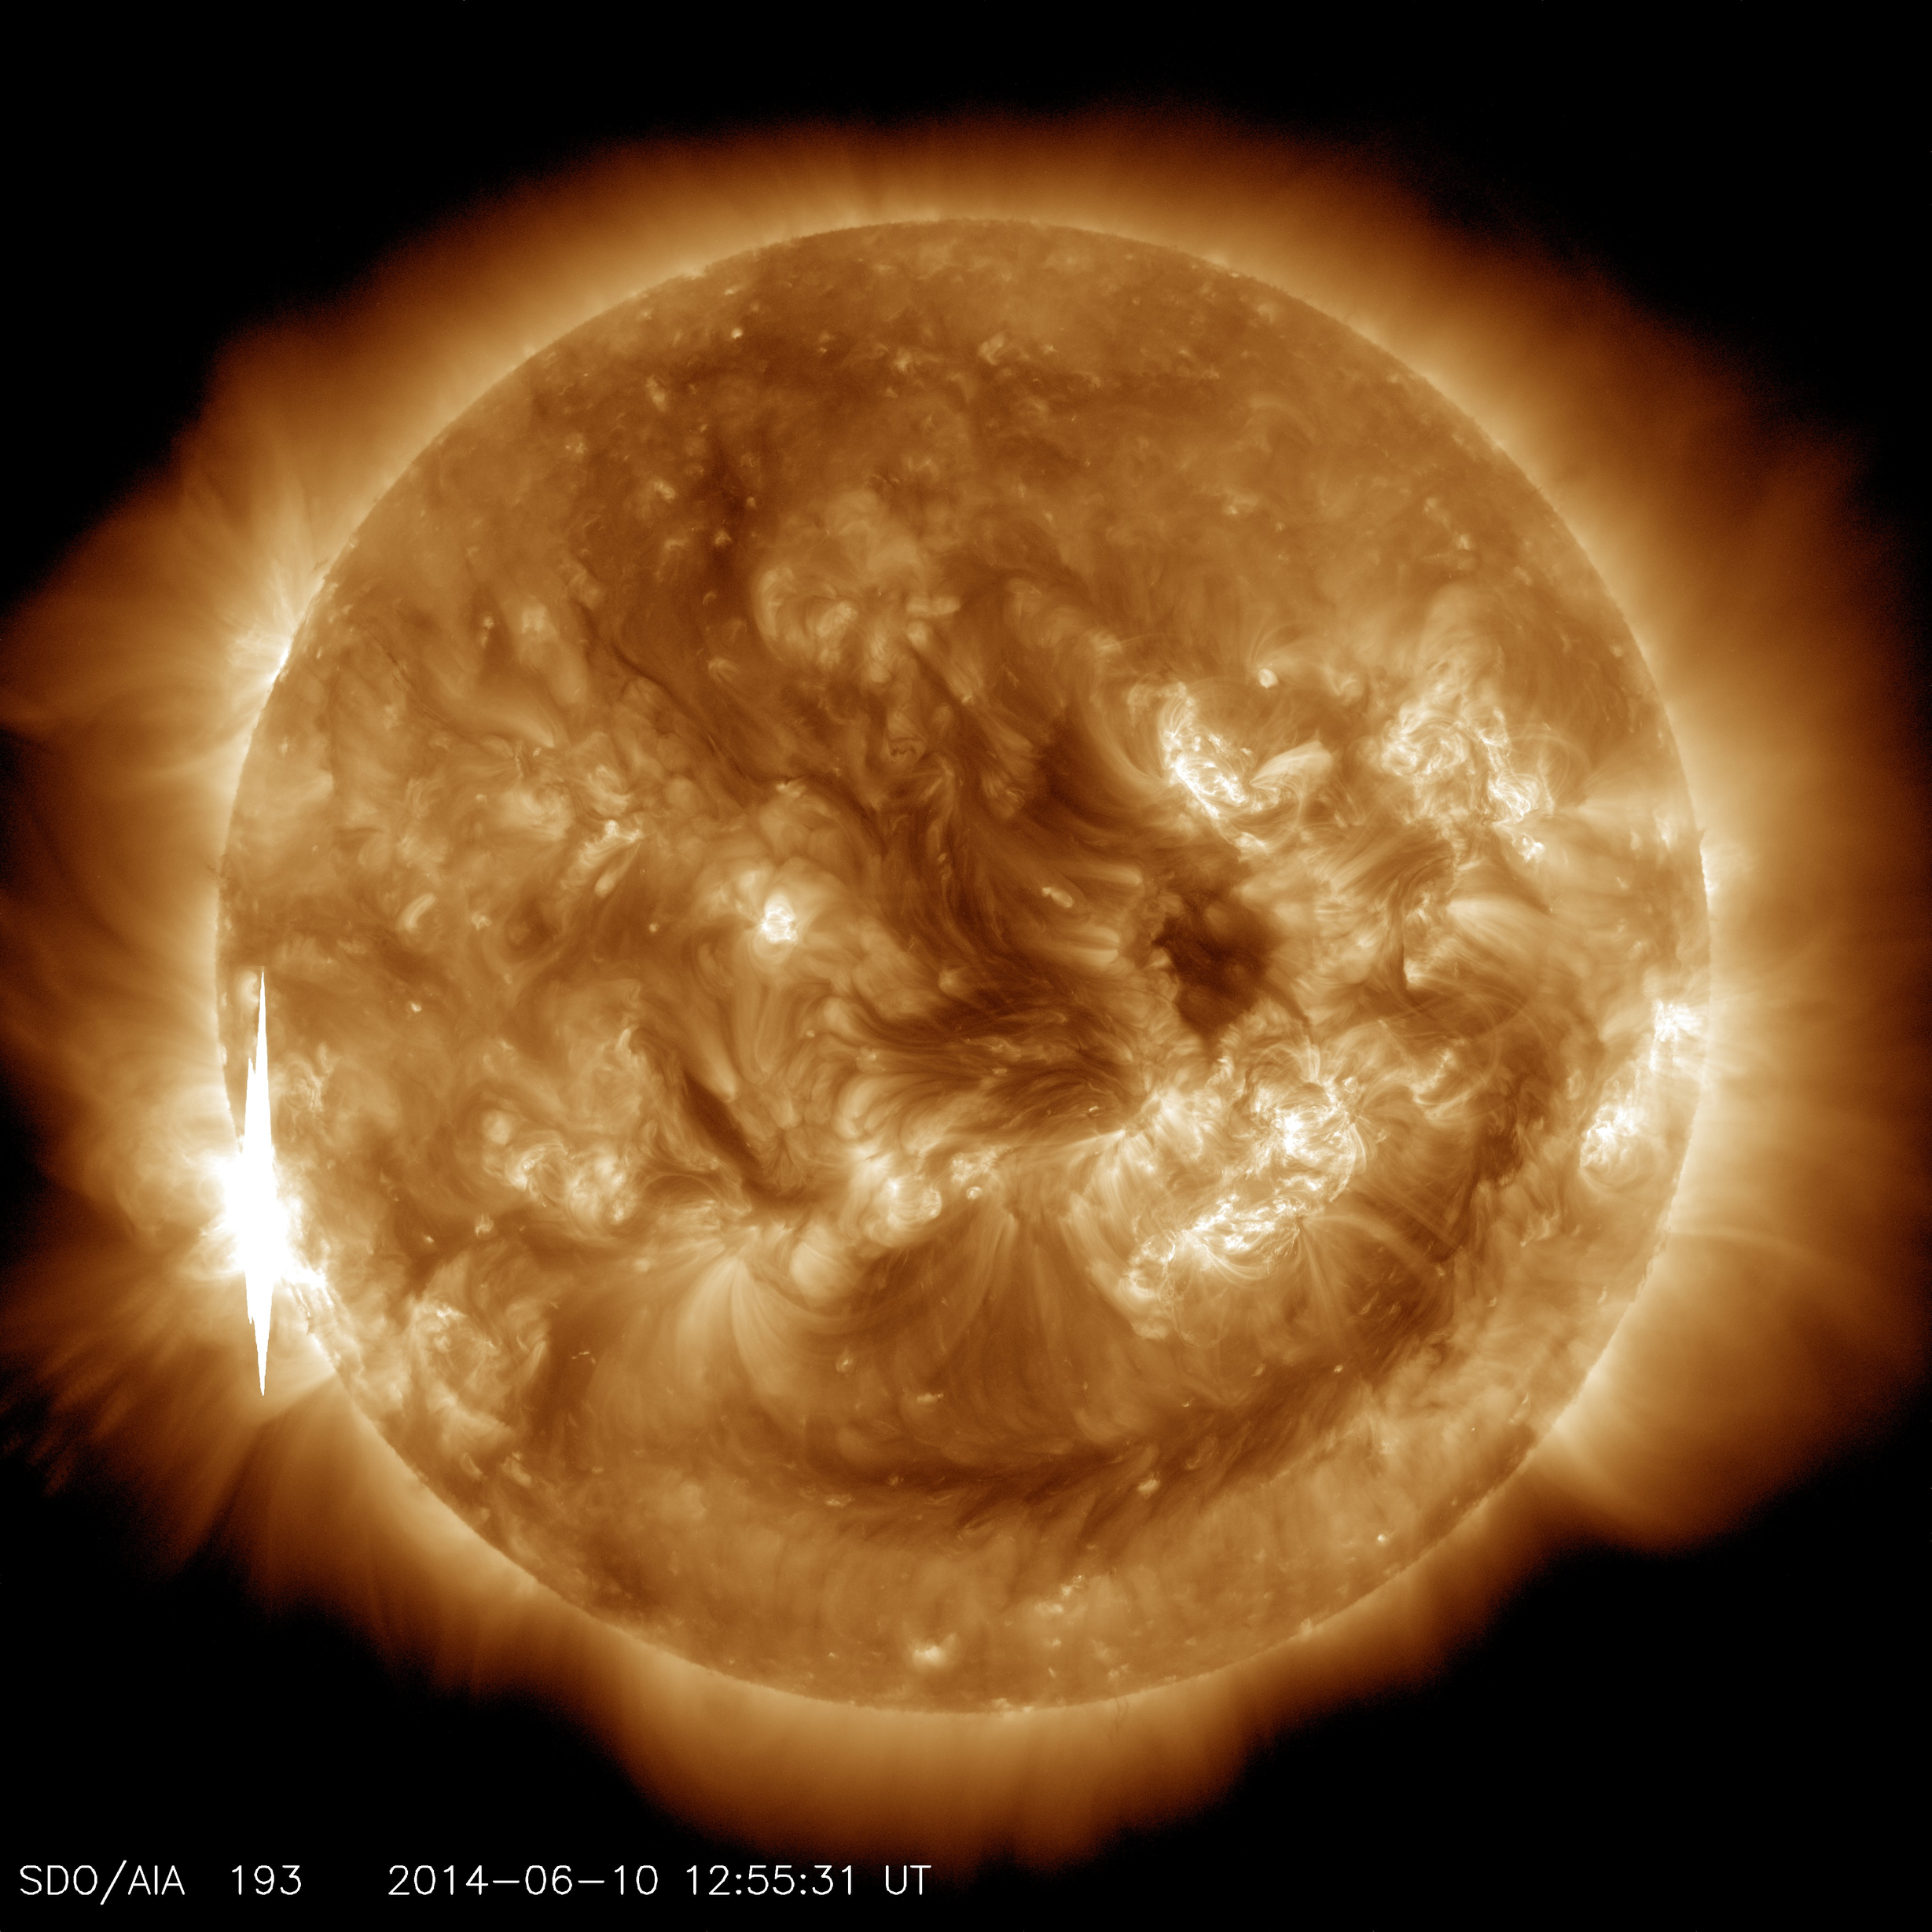
PROJECT MAGRECON
The goal of the project MagRecon is to assess the relationship between frequency of magnetic reconnection occurrences and magnetic field changes by analyzing IMF vector components. This study relies on data gathered from three separate spacecraft: Wind, ACE, and DSCOVR.
Image Credit: NASA

Slide 2
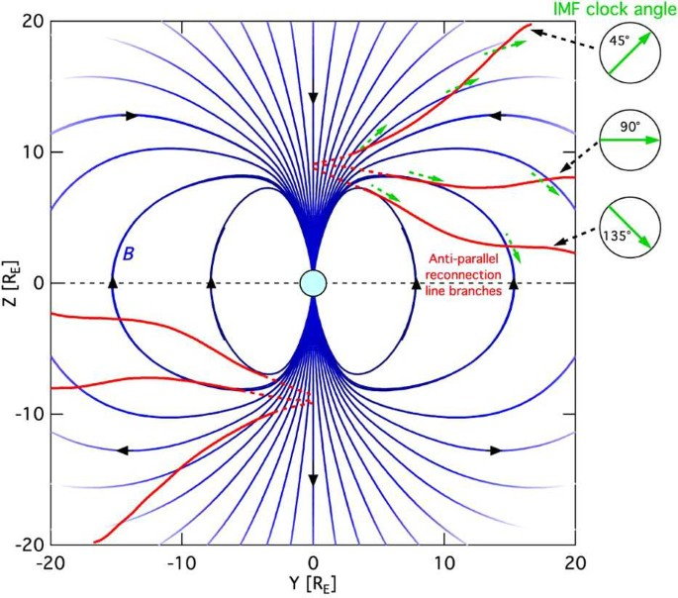
Magnetic Connection and MagRecon
Magnetic reconnection (henceforth called "reconnection") refers to the breaking and reconnecting of oppositely directed magnetic field lines in a plasma.
They power the solar flares and big solar flares they can cause powerful magnetic reconnection near Earth.
This phenomena causes a big amount of energetic particles to go along Earth’s polar axis (z-axis in the GSM coordinate system) and cause big magnetic field changes.
Project MagRecon’s aim is to analyze this phonemena and relate the vector components of IMF to magnetic field changes near Earth.
Source: Trattner, K. J., Petrinec, S. M., & Fuselier, S. A. (2021). The location of magnetic reconnection at Earth’s magnetopause. Space Science Reviews, 217(3), 41.

Slide 3
METHOD
DSCOVER
Data
WIND
Data
MagRecon
Program (Averaging and Filtering)
MagRecon
Program (Data Processing)
Results
Data from three spacecraft were used in this project. After filtering non-useful/wrong data, the averaged data from different spacecraft are being used in the program whenever possible. Then the program analyzes the data and gives the final results.
ACE
Data

Slide 4
Following our analysis of data from the solar flare events, we have concluded that a minimum threshold of 10 nT (nanoteslas) change in 15 minutes is required to evaluate if a magnetic reconnection has happened or not. Our experimentation has illustrated that magnetic interactions manifest most prominently when the z-axis magnetic field alteration exceeds the aforementioned threshold.

Slide 5
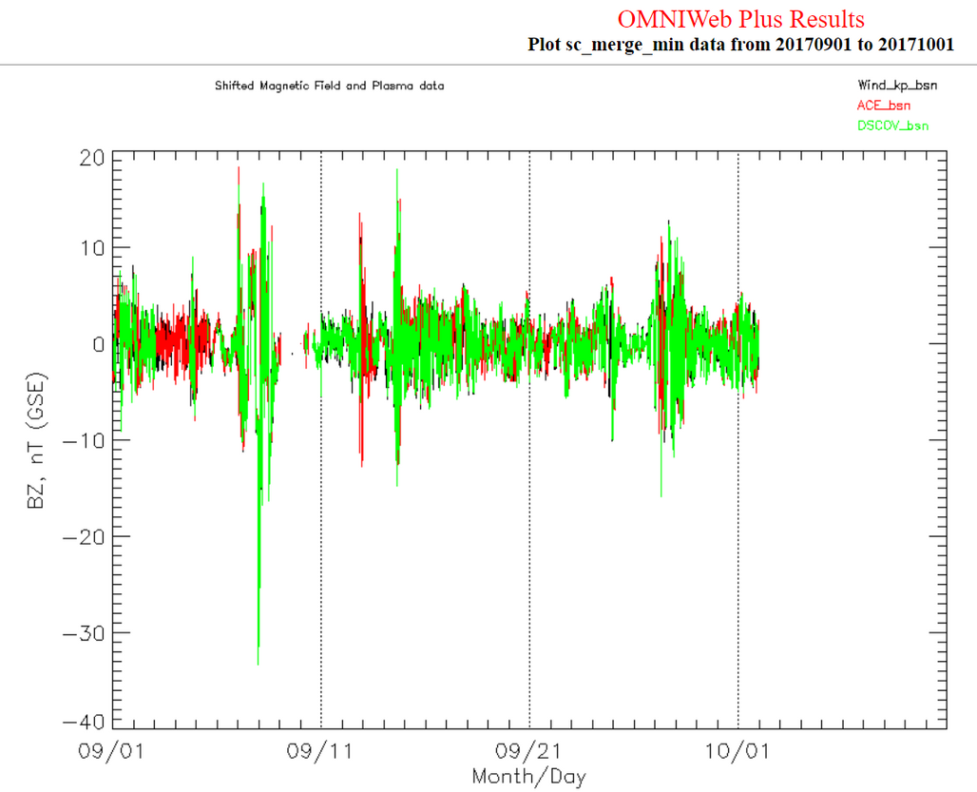
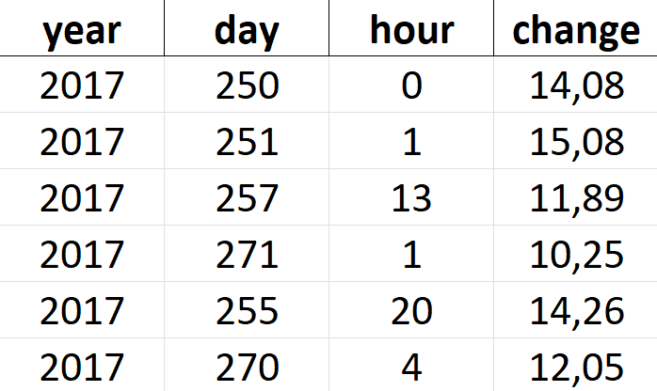
DATA ANALYSED ON THE Z-AXIS AND SPACECRAFT DATAS
(SEPTEMBER 2017, X8.2 CLASS SOLAR FLARE)¹
ANALYSE RESULTS BETWEEN
01.09.2017 - 01.10.2017 (MERGED SPACECRAFT DATA
OMNIWEB PLUS RESULTS BETWEEN 01.09.2017 - 01.10.2017
1: Zhu, B., Liu, Y. D., Kwon, R. Y., Jin, M., Lee, L. C., & Xu, X. (2021). Shock properties and associated characteristics of solar energetic particles in the 2017 September 10 ground-level enhancement event. The Astrophysical Journal, 921(1), 26.

Slide 6
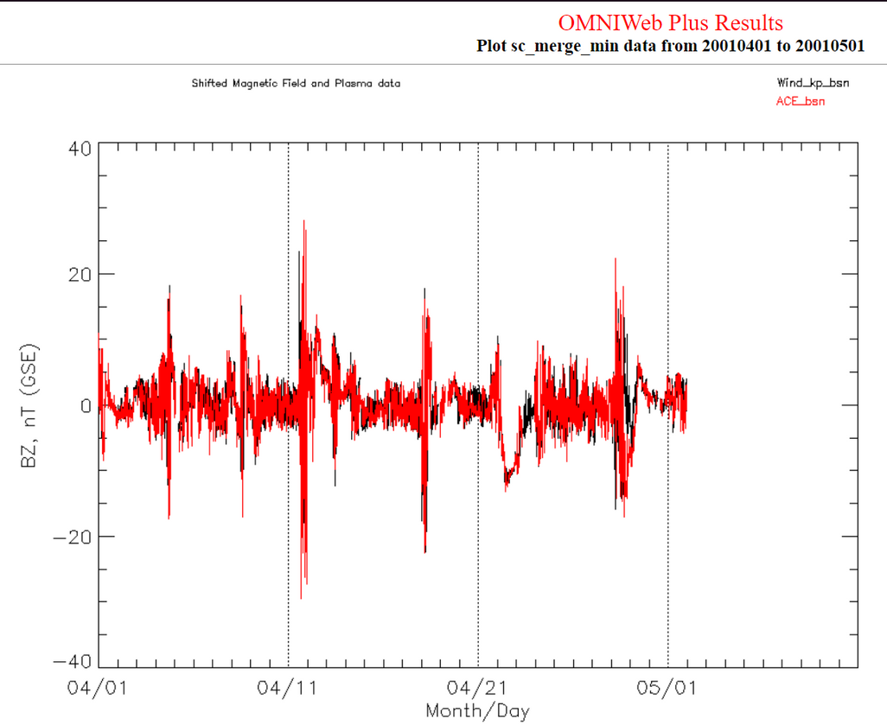
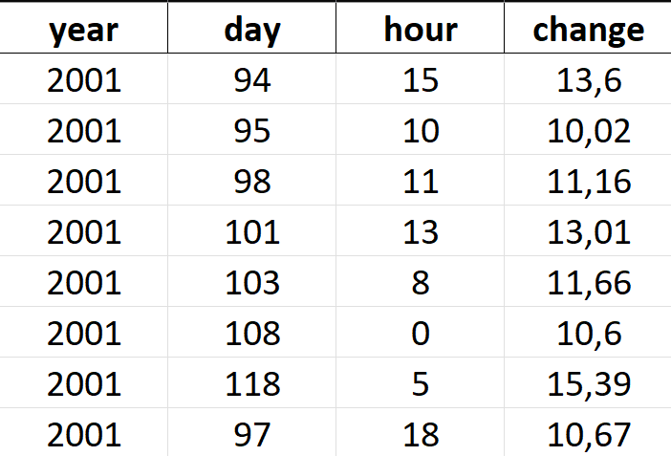
DATA ANALYSED ON THE Z-AXIS AND SPACECRAFT DATAS
(APRIL 2001, BIGGEST SOLAR X-RAY FLARE ON RECORD - X20)¹¯²
ANALYSE RESULTS BETWEEN
01.04.2001 - 01.05.2001
(ACE AND WIND DATA)
OMNIWEB PLUS RESULTS BETWEEN
01.04.2001 - 01.05.2001
1: Katamzi‐Joseph, Z. T., Habarulema, J. B., & Hernández‐Pajares, M. (2017). Midlatitude postsunset plasma bubbles observed over Europe during intense storms in April 2000 and 2001. Space Weather, 15(9), 1177-1190.
2: https://soho.nascom.nasa.gov/hotshots/X17/

